Slide 1

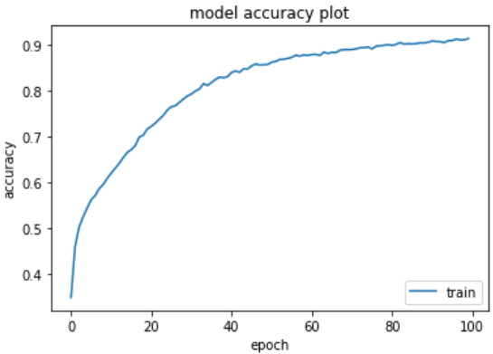
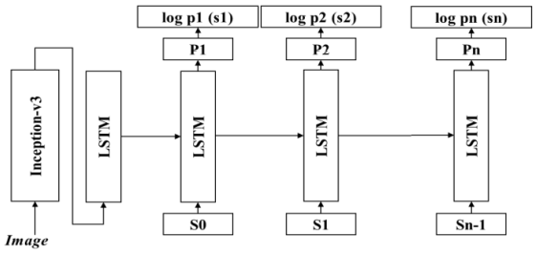
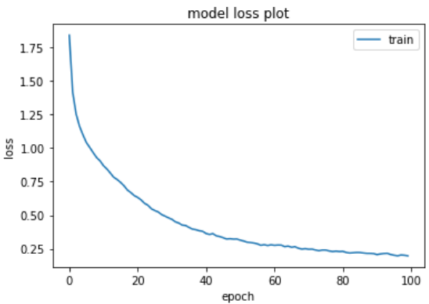
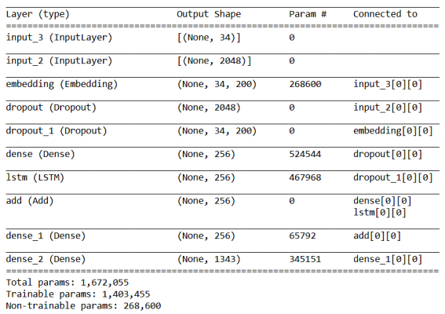
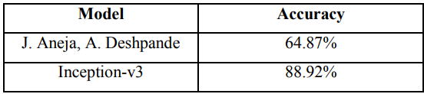

Image Captioning Using Inception V3 Transfer Learning Model
Authors: Sheshang Degadwala, Dhairya Vyas, Haimanti Biswas, Utsho Chakraborty, Sowrav Saha
TM
Methodology
This article, examine an interesting multi-modal dilemma in which Image Captioning is the most useful Deep Learning technology. A picture title is the manner in which text descriptions based on objects and image behavior can be generated from an image. This technique can be used in a wide variety of real-life applications
Results
Introduction
Proposed Model
In the proposed model, input is sent to the model Inception-v3 and the output received is sent to a new completely connected layer introduced at the end of the model Inception-v3. The layer convert the output of the model into a word embedding vector. This is fed into an LSTM cell sequence by embedding vector. The LSTM cell may rely on sequences of information and accumulate them over time. This helps to construct meaning full captions.
During the training, a pair of photos and subtitles are shown to the model. The start-v3 component of the model is taught to identify all possible object in image. In the LSTM portion, each word is predicted in the picture using previous words in a phrase. The objective of training is to reduce the failure function .
The dataset used was filker8k which has 8,000 images combined with five separate captions that offer concise explanations of the salient individuals and events.
Fig. 3. Accuracy versus Epoch plot
Fig. 1. Proposed Model Architecture
Fig. 4. Loss versus Epoch plot
Conclusion
Fig. 2. Model Summary
This Proposed system can autonomously interpret an image and provide a rational definition with 88.92% accuracy compared to other CNN methods which gives 64.87% accuracy

